Slide 1
THIS IS YOUR BOOK.
TEXT GENERATION BY RECURRENT NEURAL NETWORKS AND LONG SHORT TERM MEMORY
NATHALIA MORALES
YURI KAFFATY
FAUSTO HOLCOMBE
CHRISTIAN CASTILLO

Slide 2
1.
Understanding two different ways of writing.

Slide 3
J.R.R Tolkien is a very popular author, known to many for the Oscar-winning trilogy "The Lord of the Rings". But before being movies, the Lord of the Rings was first written. With roughly less than half million words, this trilogy of books has been loved by a lot of people.
Kiera Cass is recognized as the #1 New York Times bestselling author, due to her work in "The Selection" saga. This romantic novel is composed of four books. It's popularity gained it the New York Times Bestseller title.
Why are we even talking about two way different authors? With our knowledge on Artificial Intelligence, specifically on Recurrent Neural Networks (RNN) and Long Short Term Memory (LSTM), we wanted to merge the best of both worlds and see what we can get.

Slide 4
236,407 Palabras
1,383,150 Characters
2 Books

Slide 5
2.
The Project.

Slide 6
The project consists of training a RNN with J.R.R Tolkien's narrative alongside Kiera Cass's way of writing. The general task of the project is to create a model that generates text.
At a character-level and using the LSTM architecture, the model receives a condensed text, including the Hobbit, and the entire Lord of the Rings trilogy. As output, we receive words "written" by the machine, trying to emulate Tolkien's style.
Similarly we execute the same steps for Kiera Cass's books. But in this situation we took said books in spanish, in order to evaluate how well a RNN can adapt a change in language.

Slide 7
3.
The Solution.

Slide 8
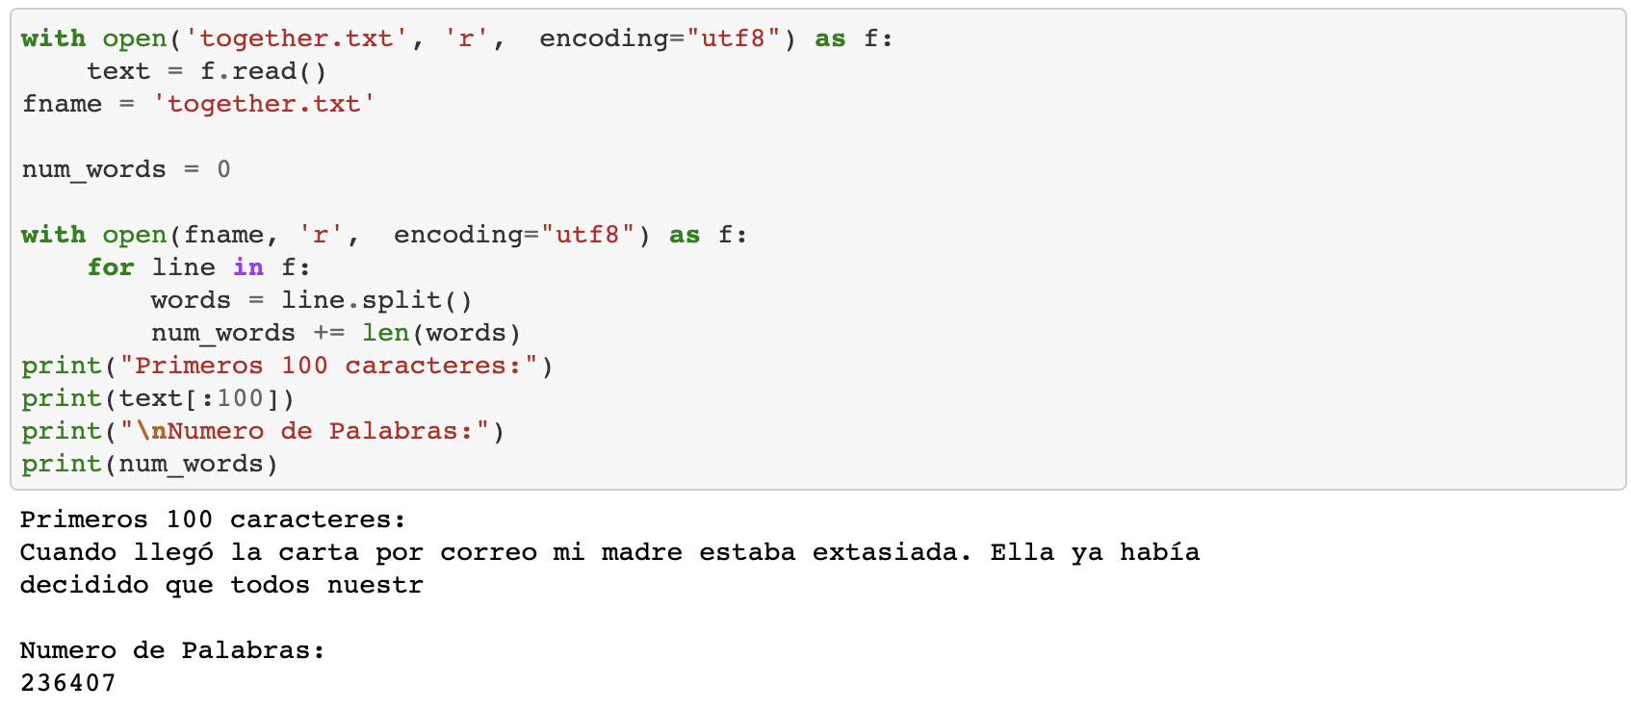
PRE-PROCESSING
We will import the dataset in Spanish. The dataset consists of the "The Selection" collection, a series of books for young people originally written in English. The dataset contains enough words and dialogues between the characters so that our model returns understandable information.

Slide 9
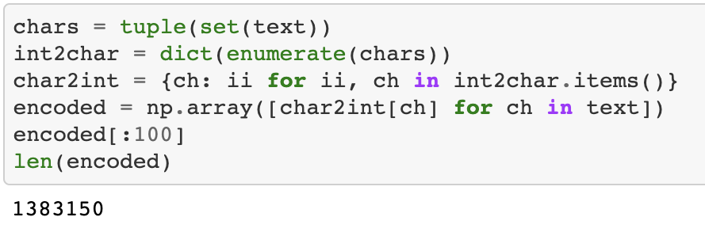
TOKENIZATION AND ONE HOT ENCODING
For the pre-processing of the data, we created dictionaries to be able to convert each character to an integer and be able to return it to the character in the future. For this we use a One-Hot-Encoding algorithm. This algorithm creates an array full of 0 and maps with a number 1 the position where this character is located.

Slide 10
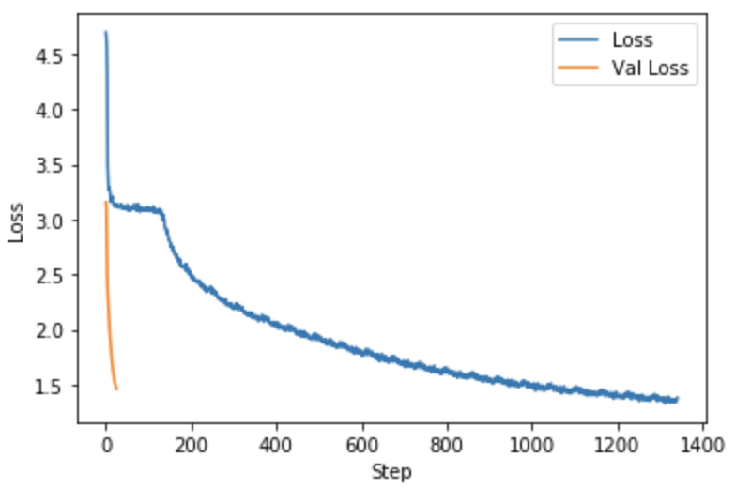
TRAINING THE MODEL
Once we have the data ready, we can create a training model for text generation. This model has a batch size of 128 and a sequence length of 150. The sequence length for the Spanish model is a bit longer since we also have to consider that we have more characters for the accents that are added to some vowels . The number of epochs was left at 22 since beyond that value the validation loss bounced in a Spanish dataset. In the dataset with English text we could leave the epochs at 26 since it took a little longer to stop optimizing the validation loss.

Slide 11
4.
Making predictions.

Slide 12

THE BOOK. SPANISH.
Pero nunca puedo confiar. Ellos sabía que se puso por la priscena con una chica de la pesión, sentida para la mano en una de ellos caminar en su cara, y ya no podría haber ser una mayora de las maneras? "¿Creí que nunca estaba en ello de ellos? " Ella sonría, sin puertas que me acorraba. —Su paso, por fué más. Me exclicó los ojos, señoritas estaba con el pramero de los problemas para su cena para mí. "¿Cuándo lis doncellas." Ella estaba destinado para se pensó a las casas y caminaban, y era una persona. "Estuvieron contenidado en la mucha parte,
el momento a esperar, pero no podía estar con su coraciente de extargar. "No estaba acerca de los palabros era algunos de mi cabeza. "¿Puedo seceridar.
"No se encantarán de los carter de todo lo mismo damas a mí. "No se era cantitada de mi pequeña conciós de mi madre y me parece en el persono en un problema. "Pero esa estaba extraña que te di cuenta de que ella pregunté. "¿Qué estaba centrado en su cabolada, pero sonreí. "¿Cómo puede sus cuando mi probe

Slide 13
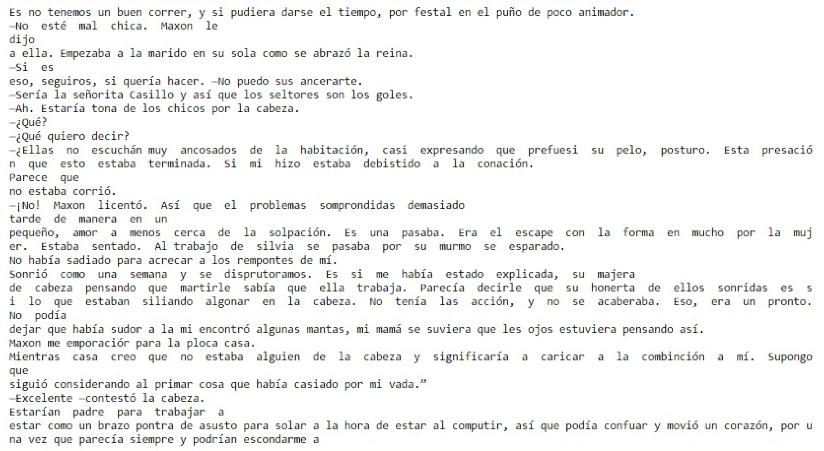
THE BOOK. SPANISH.

Slide 14
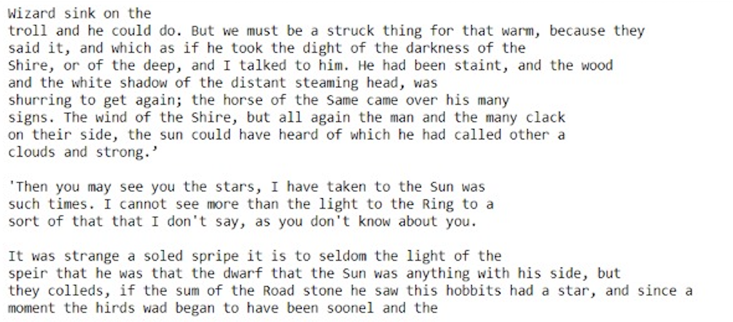
THE BOOK. ENGLISH.

Slide 15
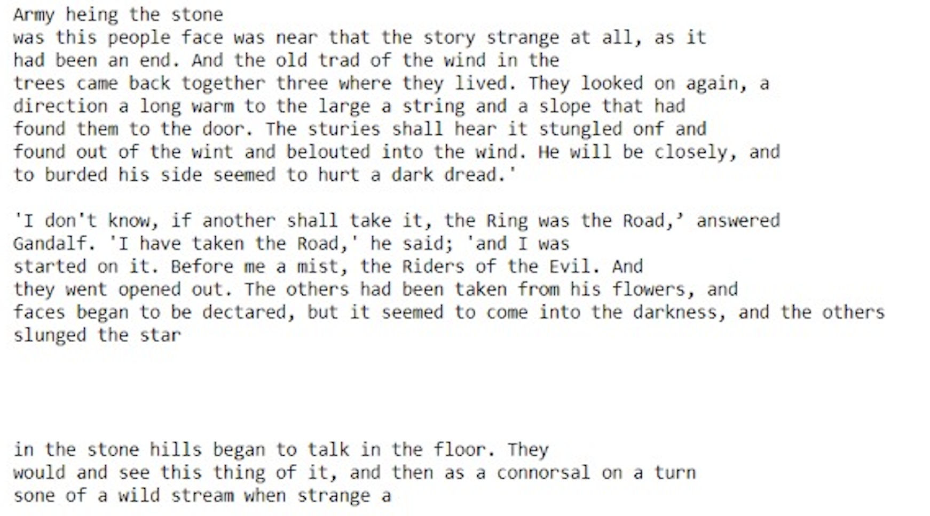
THE BOOK. ENGLISH.

Slide 16
5.
Gracias.

